Slide 1
Ch. 25/26 Warm-Up
Answer the following using the diagram below:
a common ancestor for D & F
most closely related species
least related species
new species C arises at this point
common ancestor for E & F
List 3 pieces of evidence to support the endosymbiont theory.
The half-life of carbon-14 is about 5600 years. A fossil with ¼ the normal proportion of C₁₄ is probably _______ years old.
C
D
B
E
3
4
F
A
2
5
1

Slide 2
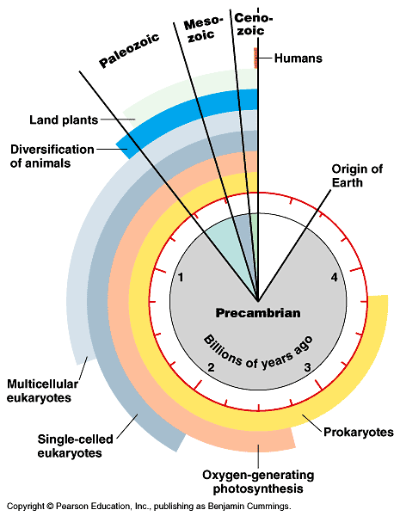
Endosymbiosis
Evolution of eukaryotes
origin of mitochondria
engulfed aerobic bacteria, but did not digest them
mutually beneficial relationship
natural selection!
internal membrane system
aerobic bacterium
mitochondrion
Endosymbiosis
Ancestral
eukaryotic cell
Eukaryotic cell
with mitochondrion

Slide 3
Endosymbiosis
Eukaryotic
cell with
mitochondrion
Evolution of eukaryotes
origin of chloroplasts
engulfed photosynthetic bacteria, but did not digest them
mutually beneficial relationship
natural selection!
photosynthetic bacterium
chloroplast
Endosymbiosis
mitochondrion
Eukaryotic cell with
chloroplast & mitochondrion

Slide 4
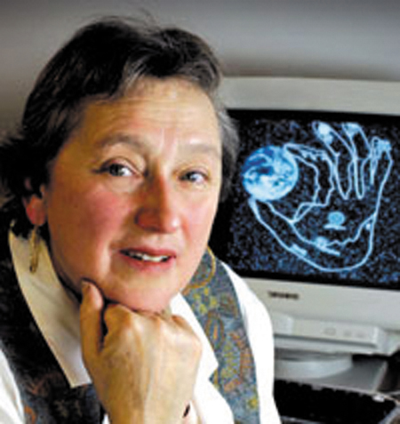
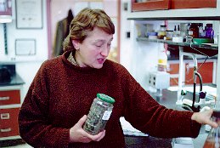
Theory of Endosymbiosis
Evidence
structural
mitochondria & chloroplasts resemble bacterial structure
genetic
mitochondria & chloroplasts have their own circular DNA, like bacteria
functional
mitochondria & chloroplasts move freely within the cell
mitochondria & chloroplasts reproduce independently from the cell
Lynn Margulis

Slide 5
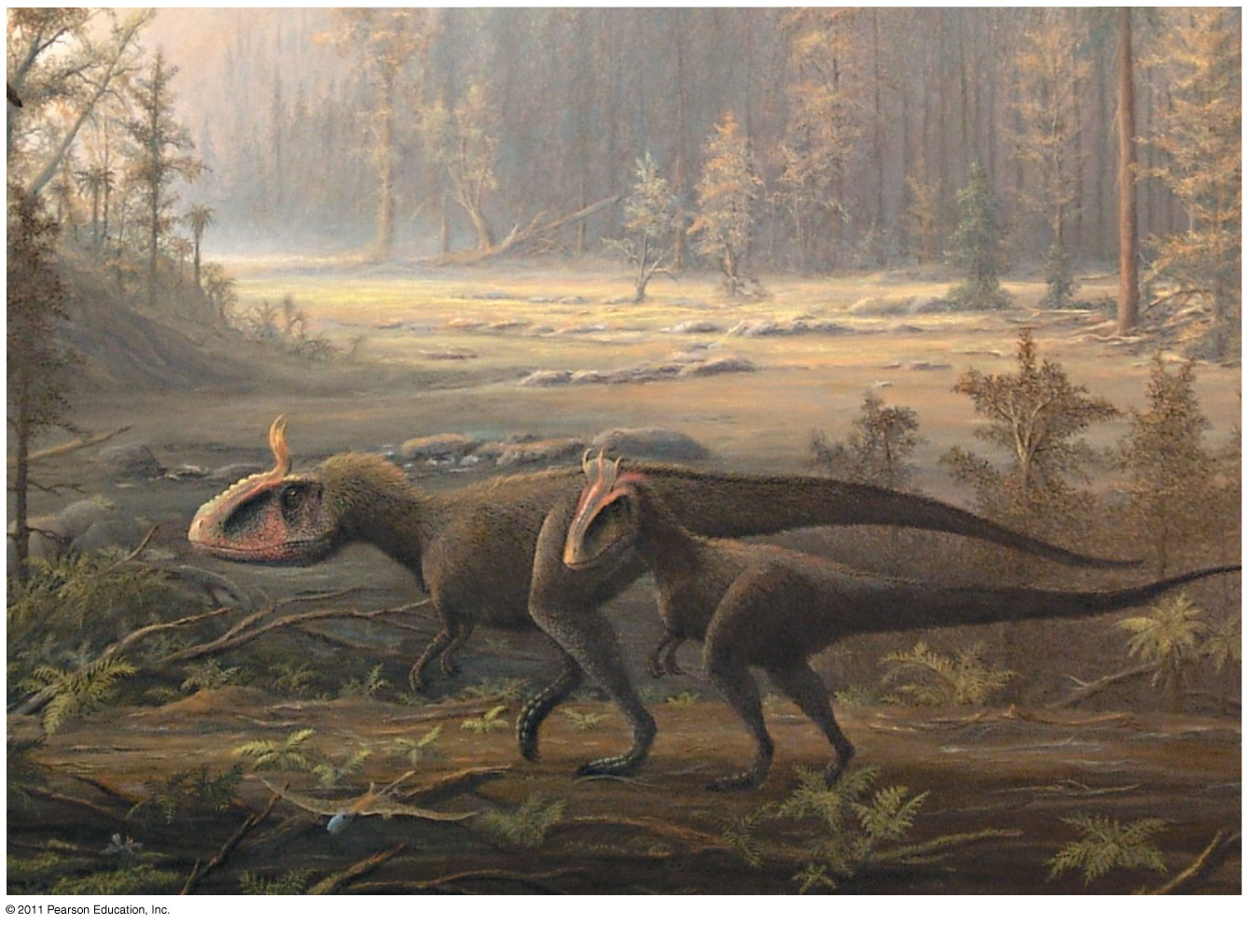
Chapter 25
The History of Life on Earth

Slide 6
What you need to know:
A scientific hypothesis about the origin of life on Earth.
The age of the Earth and when prokaryotic and eukaryotic life emerged.
Characteristics of the early planet and its atmosphere.
How Miller & Urey tested the Oparin-Haldane hypothesis and what they learned.
Methods used to date fossils and rocks and how fossil evidence contributes to our understanding of changes in life on Earth.
Evidence for endosymbiosis.
How continental drift can explain the current distribution of species.
How extinction events open habitats that may result in adaptive radiation.

Slide 7
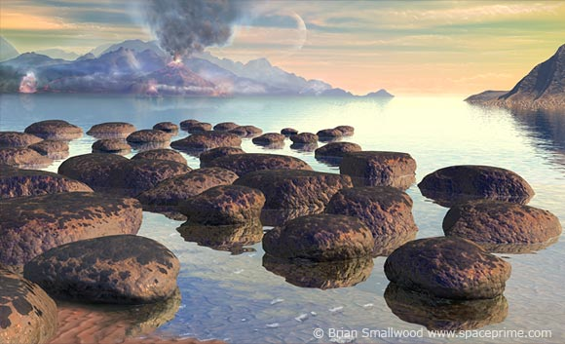
Early conditions on Earth

Slide 8
Earth = 4.6 billion years old
First life forms appeared ~3.8 billion years ago
How did life arise?
Small organic molecules were synthesized
Small molecules → macromolecules (proteins, nucleic acids)
Packaged into protocells (membrane-containing droplets)
Self-replicating molecules allow for inheritance
“RNA World”: 1st genetic material most likely RNA
First catalysts = ribozymes (RNA)

Slide 9
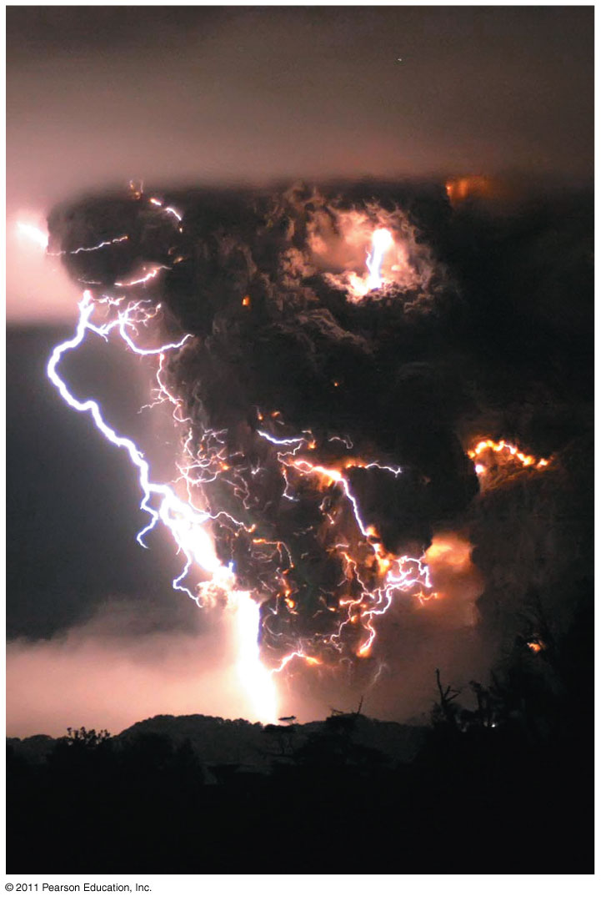
Synthesis of Organic Compounds on Early Earth
Oparin & Haldane:
Early atmosphere = H₂O vapor, N₂, CO₂, H₂, H₂S methane, ammonia
Energy = lightning & UV radiation
Conditions favored synthesis of organic compounds - a “primitive soup”

Slide 10
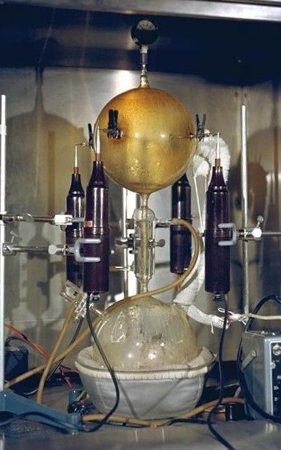
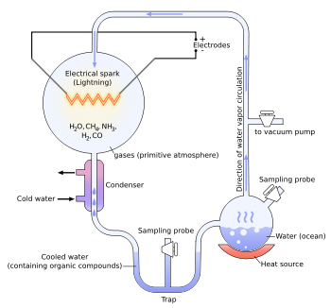
Miller & Urey:
Tested Oparin-Haldane hypothesis
Simulated conditions in lab
Produced amino acids

Slide 11
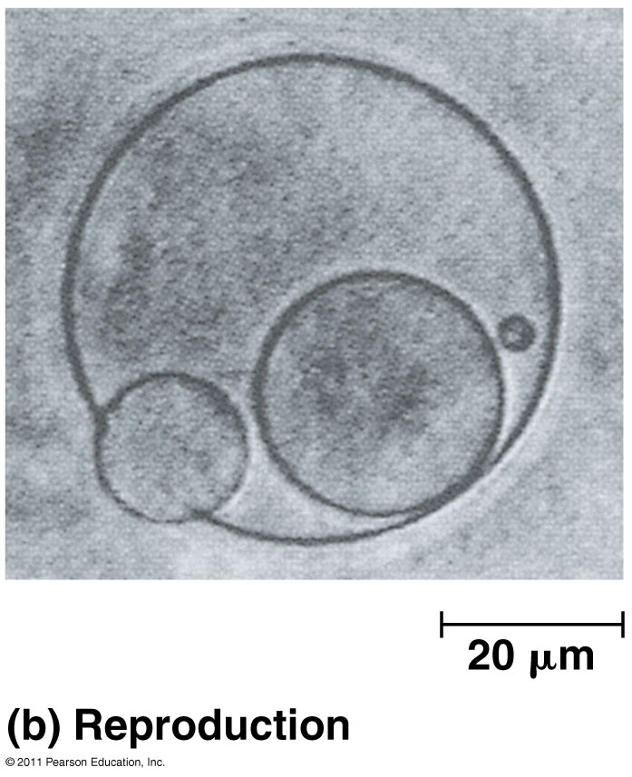
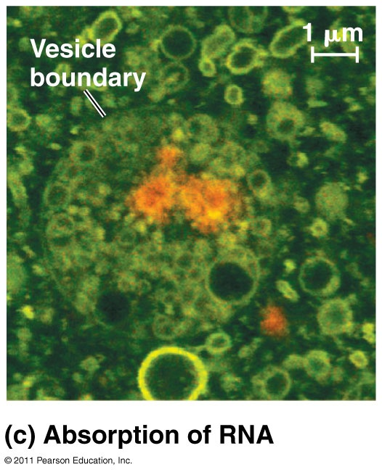
Protocells & Self-Replicating RNA

Slide 12
Fossil Record: used to reconstruct history
Sedimentary rock (layers called strata)
Mineralized (hard body structures)
Organic – rare in fossils but found in amber, frozen, tar pits
Incomplete record – many organisms not preserved, fossils destroyed, or not yet found

Slide 13
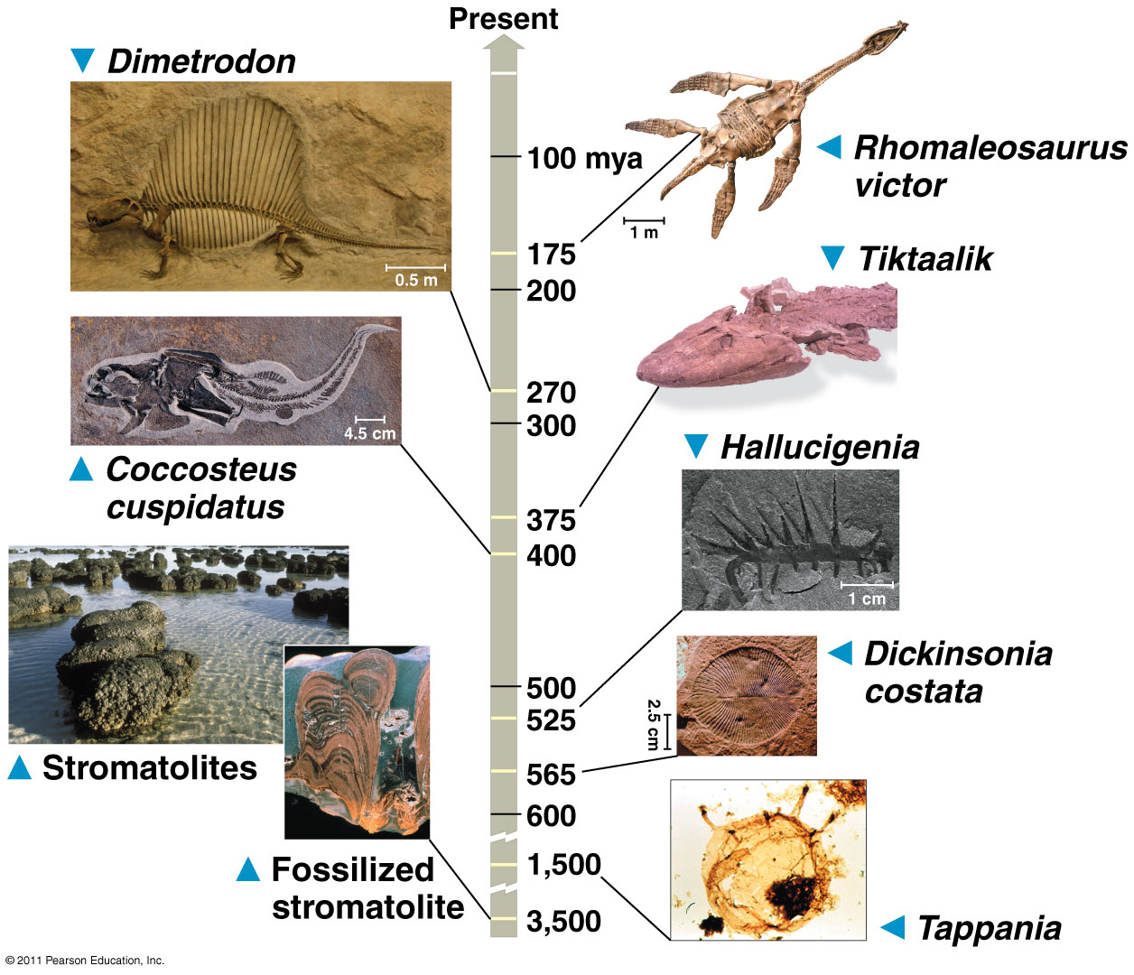

Slide 14
Relative Dating
Radiometric Dating
Both used to date fossils and determine age
Uses order of rock strata to determine relative age of fossils
Measure decay of radioactive isotopes present in layers where fossils are found
Half-life: # of years for 50% of original sample to decay

Slide 15
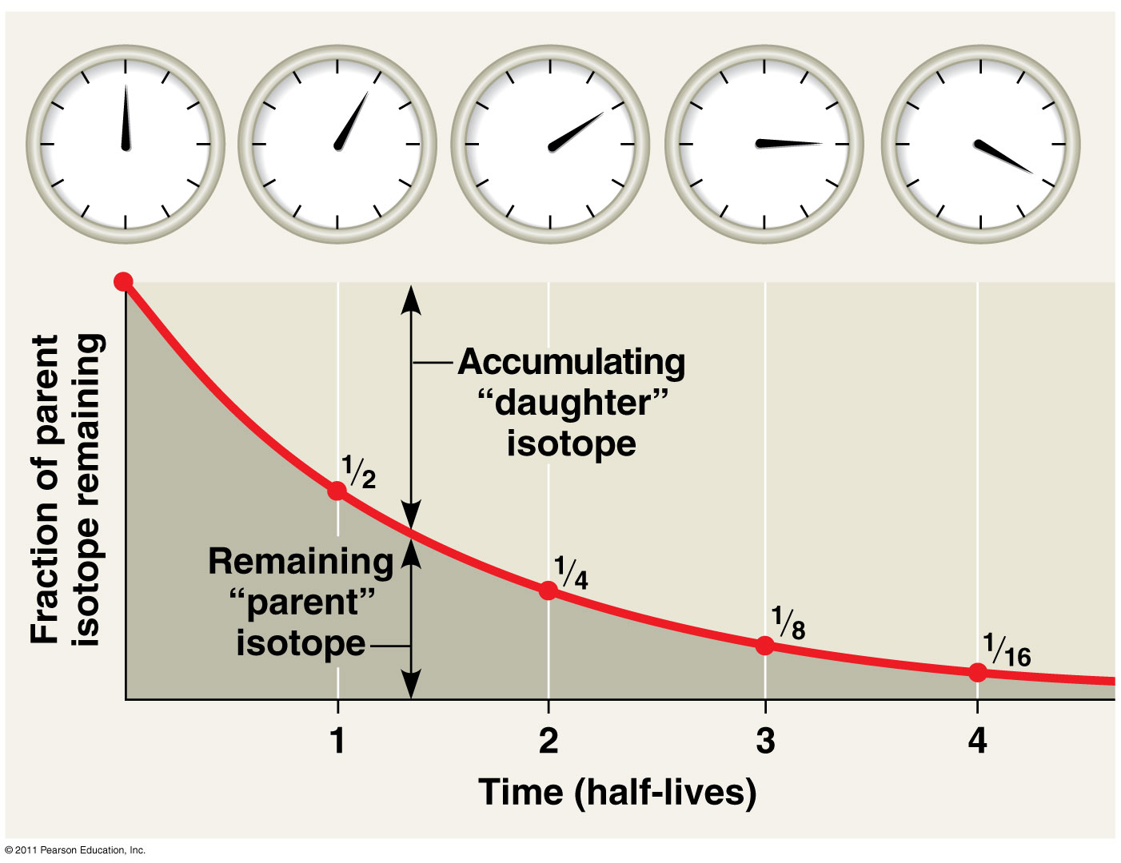

Slide 16
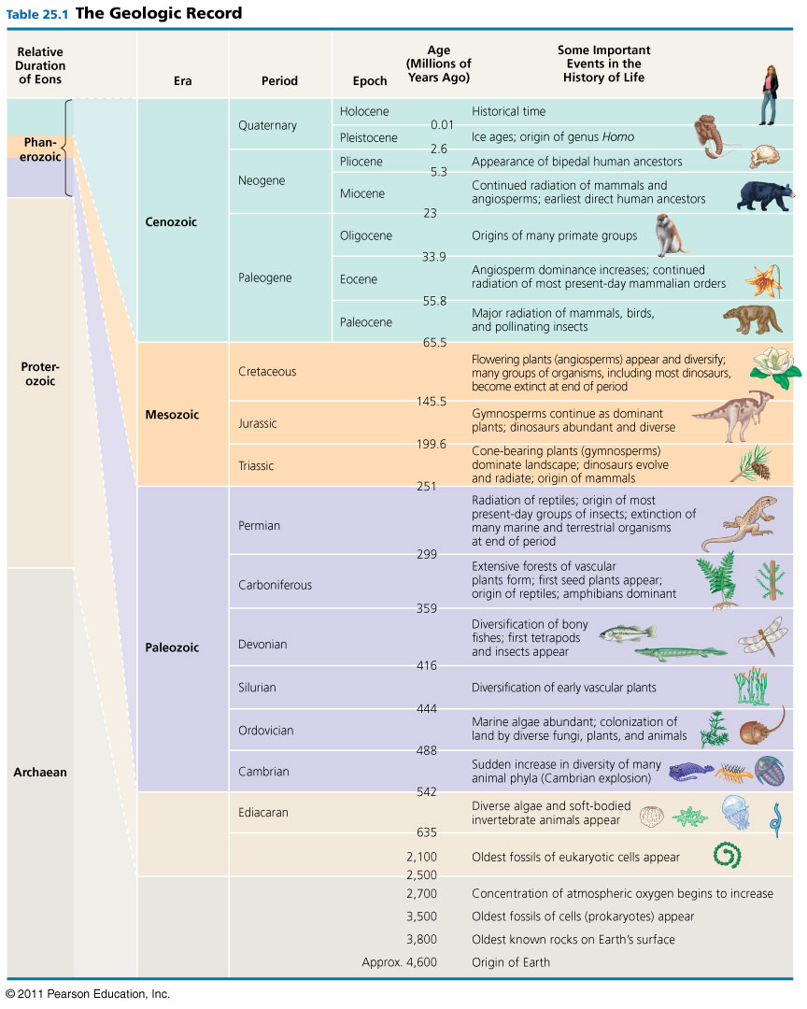
Geologic Time Scale
Eon → Era → Period → Epoch (longest to shortest)
Present Day: Phanerozoic Eon, Cenozoic Era, Quaternary Period, Holocene Epoch

Slide 17
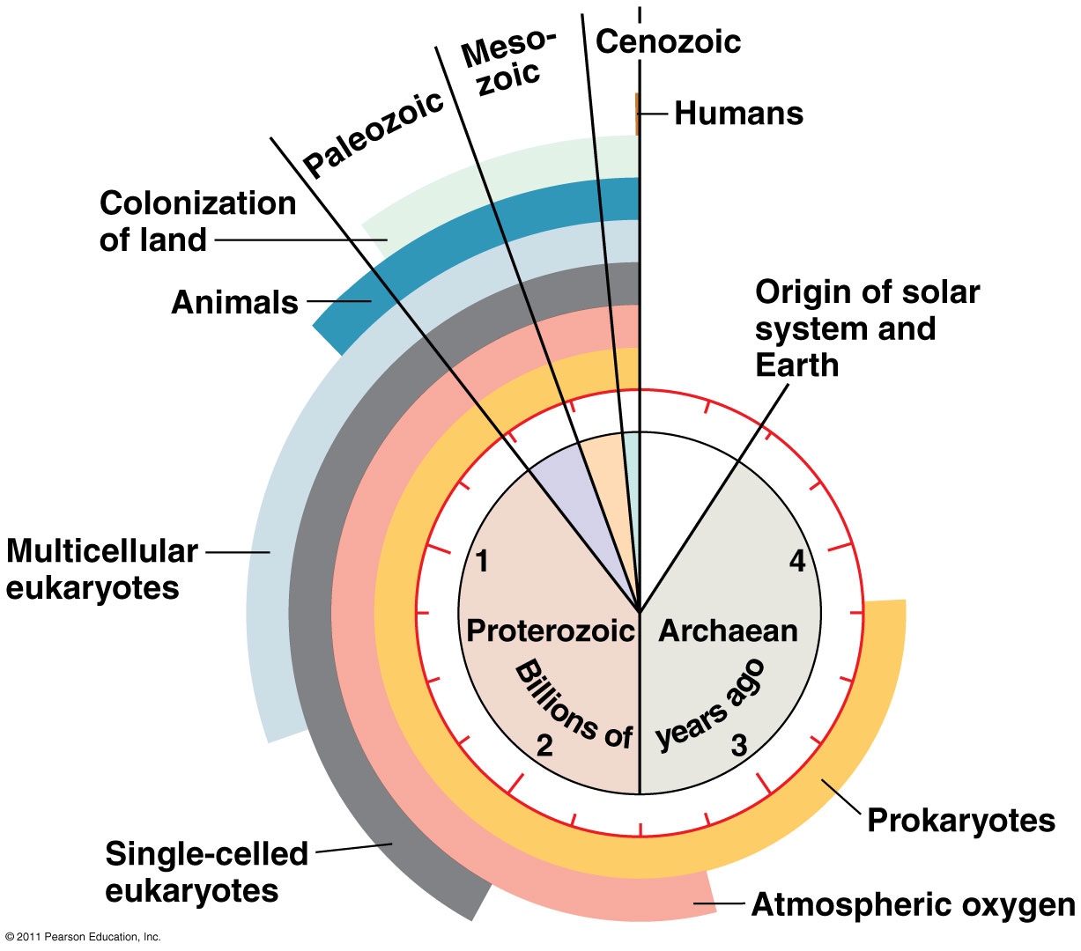
Clock Analogy of Earth’s History

Slide 18
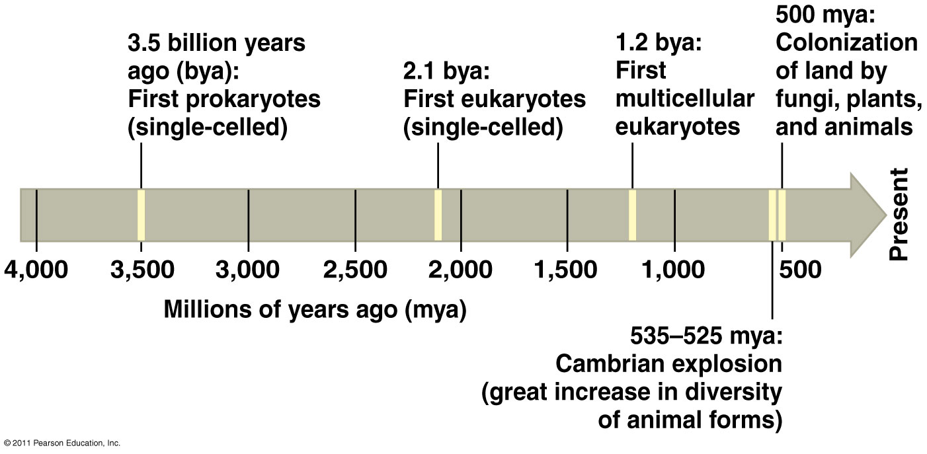
Key Events in Life’s History
O₂ accumulates in atmosphere
(2.7 bya)
Humans
(200,000)

Slide 19
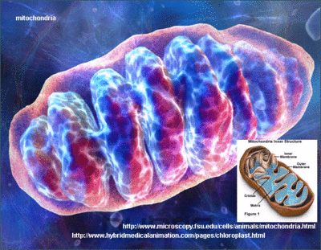
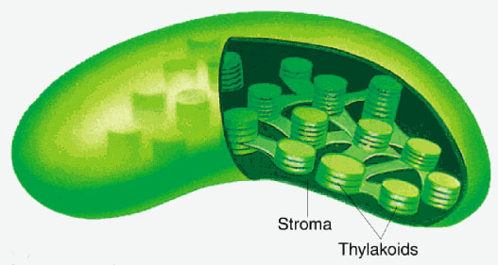
Endosymbiont Theory
Mitochondria & plastids (chloroplasts) formed from small prokaryotes living in larger cells
Evidence:
Replication by binary fission
Single, circular DNA (no histones)
Ribosomes to make proteins
Enzymes similar to living prokaryotes
Two membranes

Slide 20
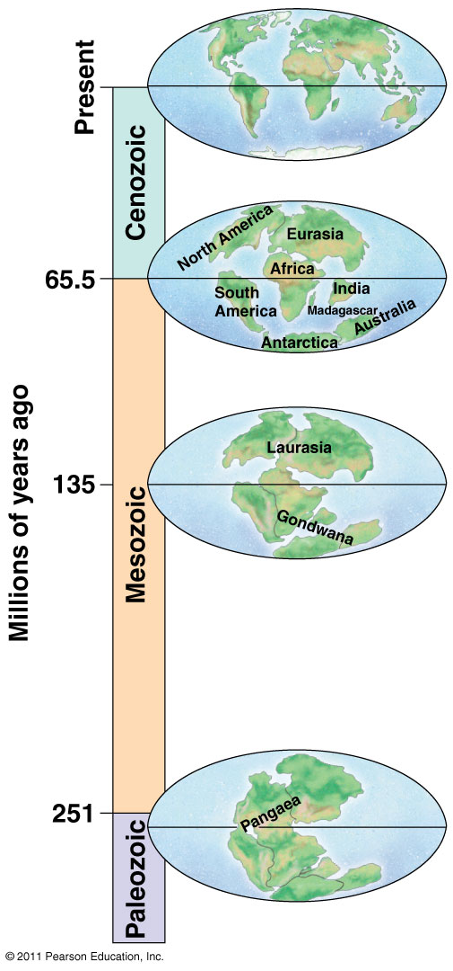
Pangaea = Supercontinent
Formed 250 mya
Continental drift explains many biogeographic puzzles

Slide 21
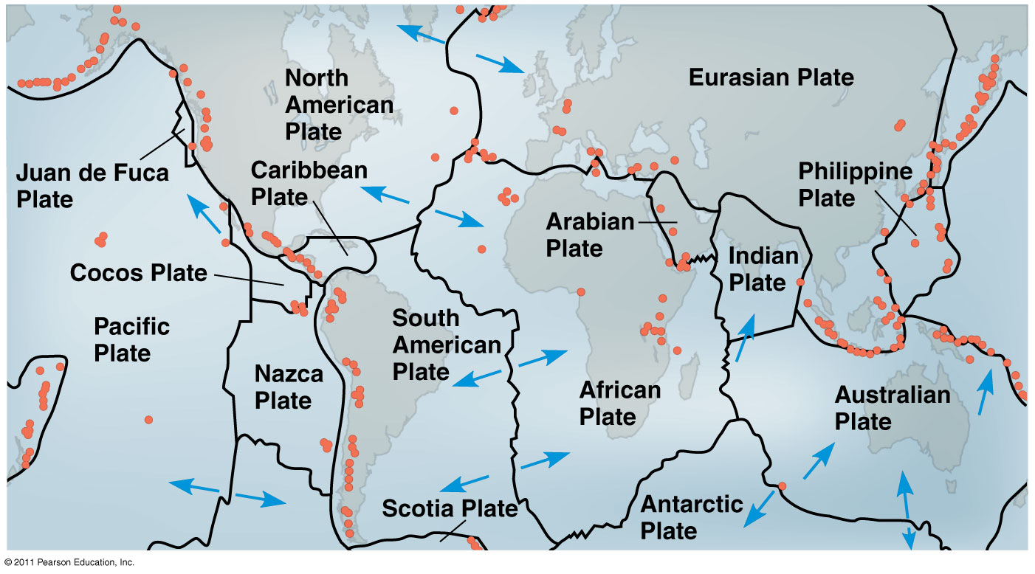
Movement of continental plates change geography and climate of Earth → Extinctions and speciation

Slide 22
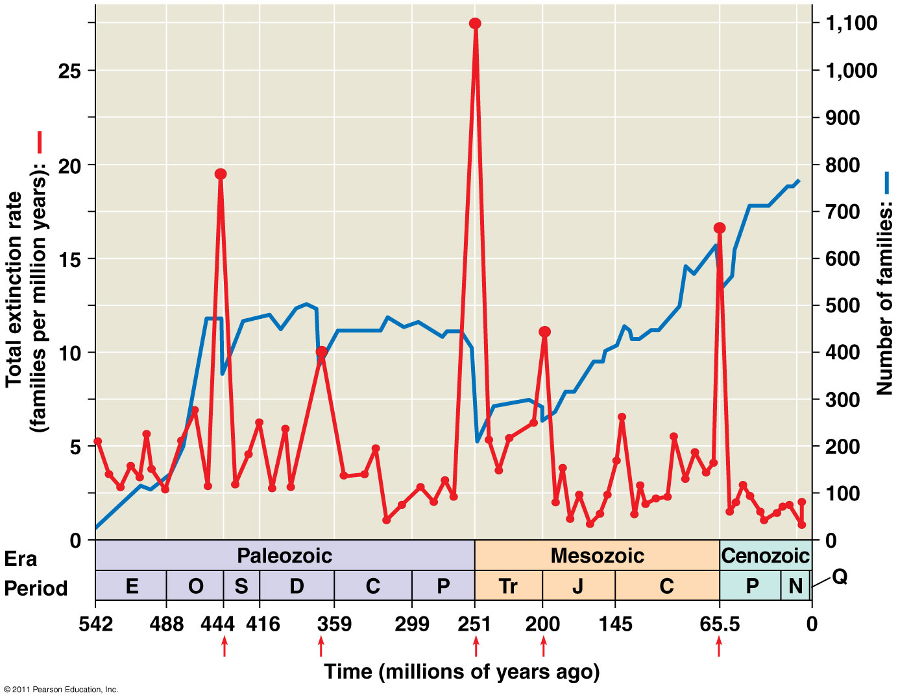
Mass extinctions → Diversity of life
Major periods in Earth’s history end with mass extinctions and new ones begin with adaptive radiations

Slide 23
Major events during each Era
Precambrian: microscopic fossils (stromatolites)
Photosynthesis, atmospheric O₂
Eukaryotes (endosymbiont theory)
Paleozoic: Cambrian Explosion
Plants invade land, many animals appear
Permian Extinction (-96% species)
Mesozoic: “Age of Reptiles”, dinosaur, plants
Formation of Pangaea supercontinent
Cretaceous Extinction – asteroid off Mexico’s coast
Cenozoic: Primates
Note: All end with major extinction & start with adaptive radiation

Slide 24
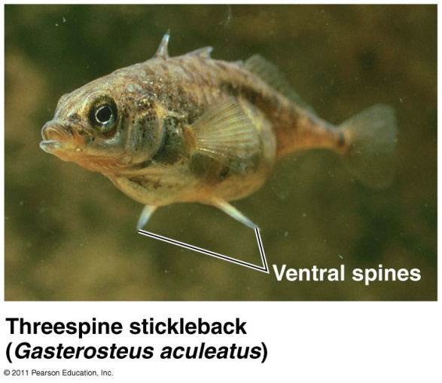
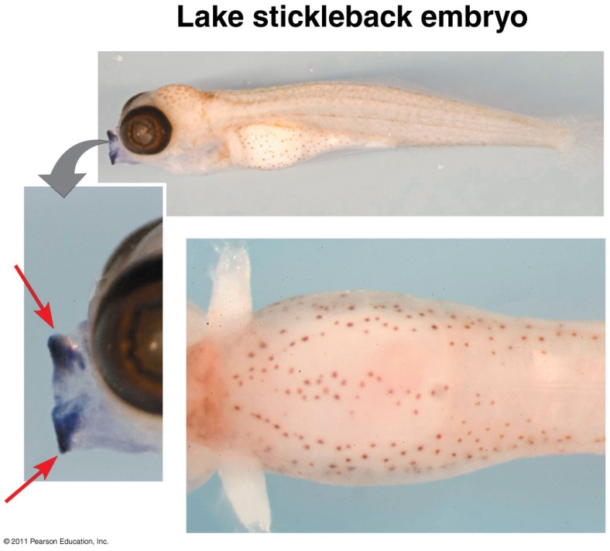
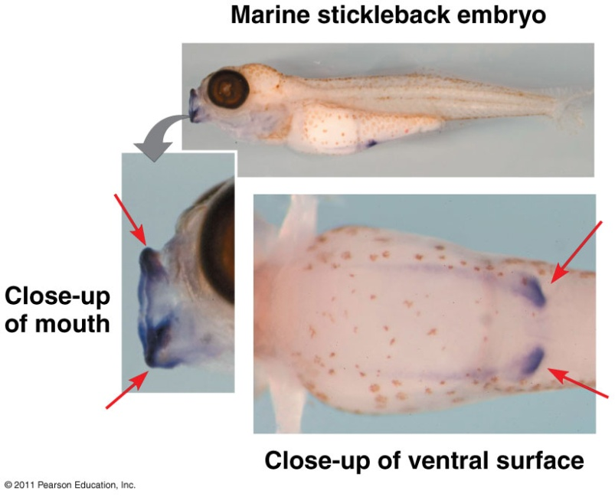
Evo-Devo: evolutionary + developmental biology
Evolution of new forms results from changes in DNA or regulation of developmental genes

Slide 25
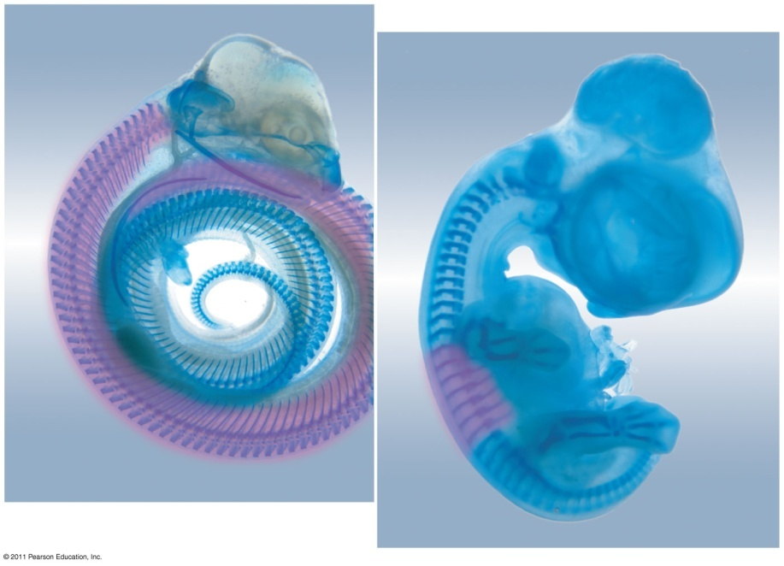
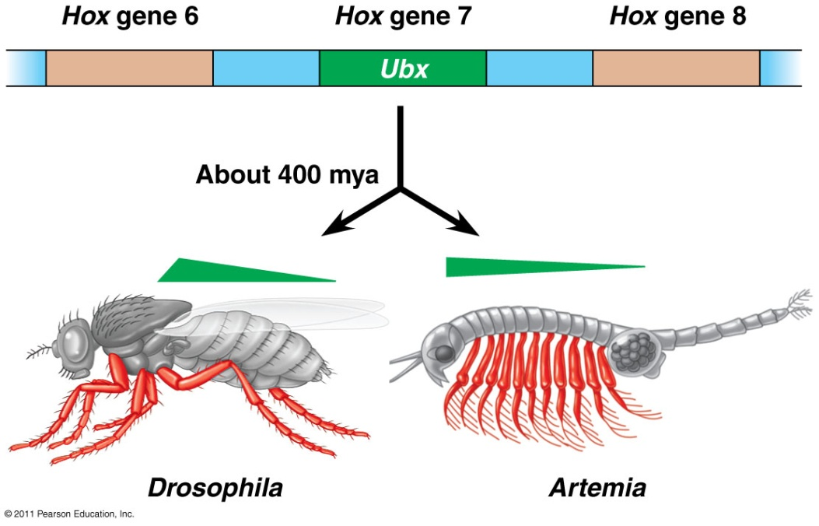
Homeotic genes: master regulatory genes determine location and organization of body parts
Eg. Hox genes
Evolution of Hox genes changes the insect body plan.
Hox gene expression and limb development.

