Slide 1
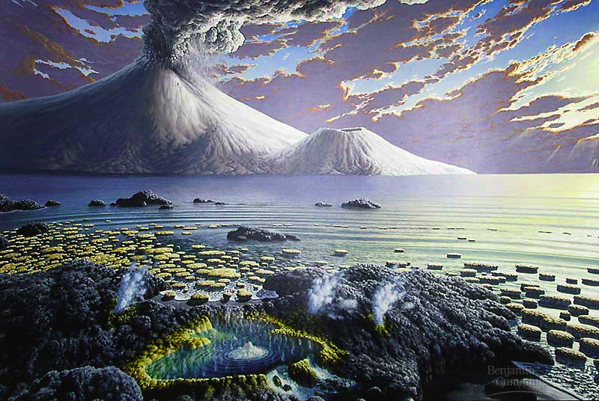
“…sparked by just the right combination of physical events & chemical processes…”
Origin of Life

Slide 2
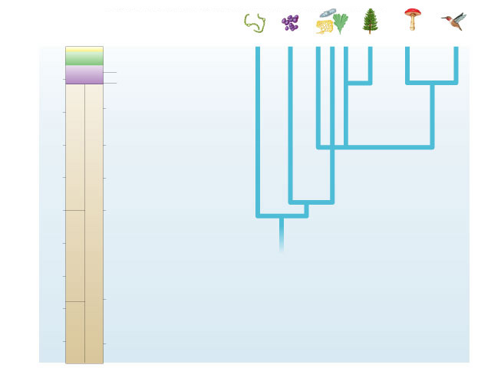
0
Bacteria
Archae-
bacteria
Protista
Plantae
Fungi
Animalia
Cenozoic
Mesozoic
Colonization of land
by animals
500
Paleozoic
Appearance of animals
and land plants
1000
First multicellular
organisms
PROTEROZOIC
Oldest definite fossils
of eukaryotes
1500
2000
Appearance of oxygen
in atmosphere
PRECAMBRIAN
Millions of years ago
2500
Oldest definite fossils
of prokaryotes
3000
The evolutionary tree of life can be documented with evidence.
The Origin of Life on Earth is another story…
ARCHEAN
3500
Molten-hot surface of
earth becomes cooler
4000
4500
Formation of earth

Slide 3
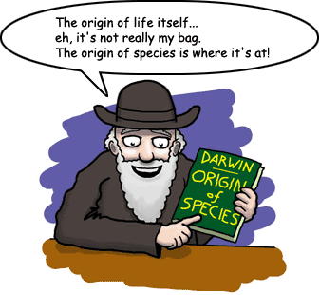
What is Life?
First we have to define LIFE…
  organized as cells
  respond to stimuli
  regulate internal processes
    homeostasis
  use energy to grow
    metabolism
  develop
    change & mature
    within lifetime
  reproduce
    heredity
      DNA / RNA
    adaptation & evolution

Slide 4
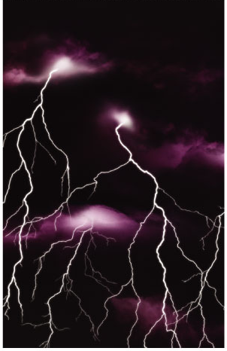
The Origin of Life is Hypothesis
Special Creation
  Was life created by a supernatural or divine force?
  not testable
Extraterrestrial Origin
  Was the original source of organic (carbon) materials comets & meteorites striking early Earth?
  testable
Spontaneous Abiotic Origin
  Did life evolve spontaneously from inorganic molecules?
  testable

Slide 5
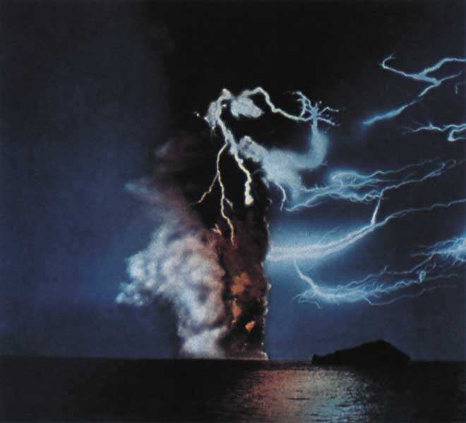
Conditions on early Earth
Reducing atmosphere
  water vapor (H₂O), CO₂, N₂, NO_{x}, H₂, NH₃, CH₄, H₂S
  lots of available H & its electron
  no free oxygen
Energy source
  lightning, UV radiation,
  volcanic
low O₂ =
organic molecules do not breakdown as quickly
What’s missing
from that
atmosphere?
Notes:
It is unclear whether young Earth’s atmosphere contained enough methane and ammonia to be reducing. Growing evidence suggests that the early atmosphere was made up primarily of nitrogen and carbon dioxide and was neither reducing nor oxidizing (electron–removing). Miller–Urey–type experiments using such atmospheres have not produced organic molecules. Still, it is likely that small “pockets” of the early atmosphere—perhaps near volcanic openings—were reducing.
Instead of forming in the atmosphere, the first organic compounds on Earth may have been synthesized near submerged volcanoes and deep–sea vents—weak points in Earth’s crust where hot water and minerals gush into the ocean.

Slide 6
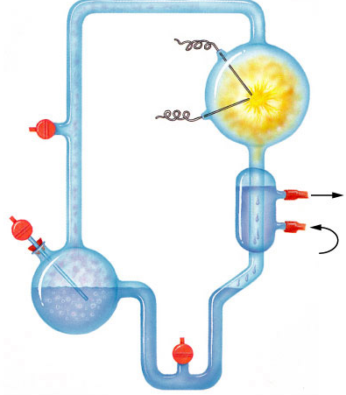
Origin of Organic Molecules
Electrodes discharge
sparks
(lightning simulation)
Abiotic synthesis
  1920
  Oparin & Haldane propose reducing atmosphere hypothesis
  1953
  Miller & Urey
  test hypothesis
    formed organic compounds
      amino acids
      adenine
CH₄
Water vapor
H₂
NH₃
Mixture of gases
("primitive
atmosphere")
Condenser
Water
Condensed liquid with complex, organic
molecules
Heated water
("ocean")

Slide 7
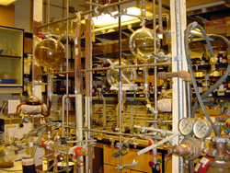
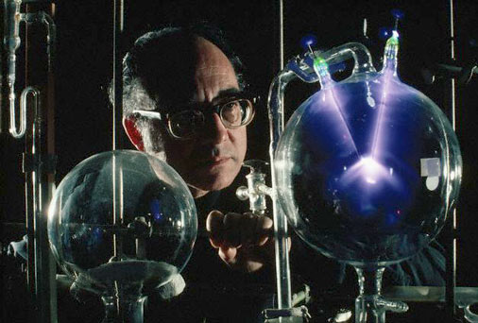

Stanley Miller
University of Chicago
produced
-amino acids
-hydrocarbons
-nitrogen bases
-other organics
It’s ALIVE!

Slide 8
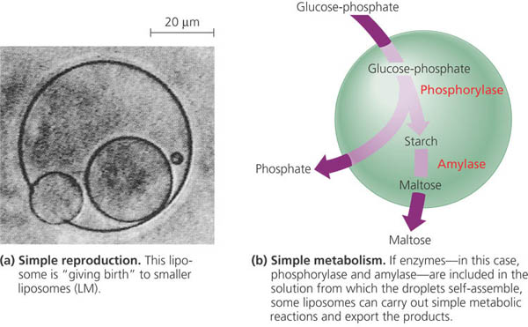
Origin of Cells (Protobionts)
Bubbles → separate inside from outside
→ metabolism & reproduction
Bubbles…
Tiny bubbles…
Notes:
Life is defined partly by two properties: accurate replication and metabolism. Neither property can exist without the other. Self–replicating molecules and a metabolism–like source of the building blocks must have appeared together. How did that happen?
The necessary conditions for life may have been met by protobionts, aggregates of abiotically produced molecules surrounded by a membrane or membrane–like structure. Protobionts exhibit some of the properties associated with life, including simple reproduction and metabolism, as well as the maintenance of an internal chemical environment different from that of their surroundings.
Laboratory experiments demonstrate that protobionts could have formed spontaneously from abiotically produced organic compounds. For example, small membrane–bounded droplets called liposomes can form when lipids or other organic molecules are added to water.

Slide 9
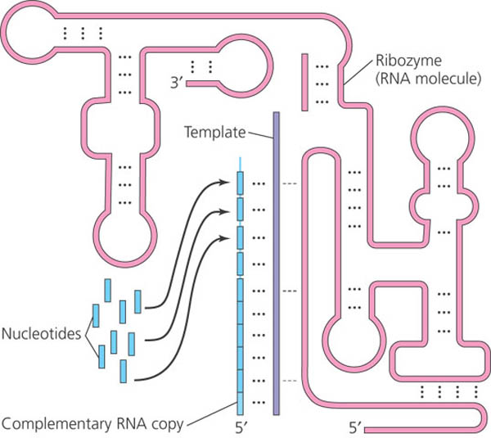
Origin of Genetics
Dawn of natural selection
RNA is likely first genetic material
  multi-functional
  codes information
    self-replicating molecule
    makes inheritance possible
    natural selection & evolution
  enzyme functions
    ribozymes
    replication
  regulatory molecule
  transport molecule
    tRNA & mRNA
Notes:
Why RNA?
RNA molecules are important catalysts in modern cells. Modern cells use RNA catalysts, called ribozymes, to remove introns from RNA. Ribozymes also help catalyze the synthesis of new RNA, notably rRNA, tRNA, and mRNA. Thus, RNA is autocatalytic, and in the prebiotic world, before there were enzymes (proteins) or DNA, RNA molecules may have been fully capable of ribozyme-catalyzed replication.

Slide 10
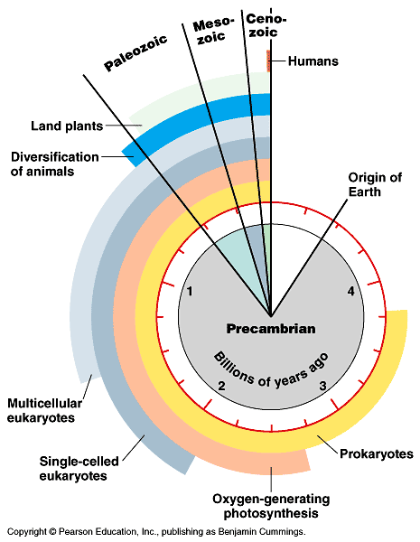
Key Events in Origin of Life
Key events in evolutionary history of life on Earth
  life originated 3.5–4.0 bya

Slide 11
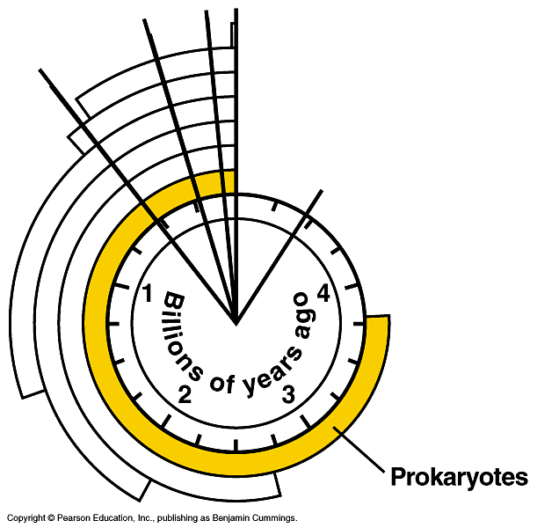
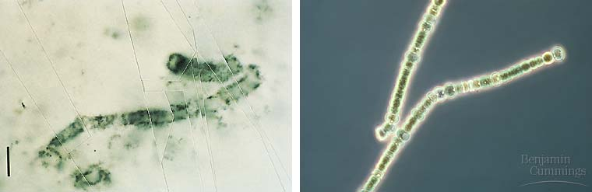
Prokaryotes
Prokaryotes dominated life
on Earth from 3.5–2.0 bya
3.5 billion year old
fossil of bacteria
modern bacteria
chains of one-celled
cyanobacteria
Notes:
Electron Transport Systems
The chemiosmotic mechanism of ATP synthesis, in which a complex set of membrane–bound proteins pass electrons to reducible electron acceptors with the generation of ATP from ADP, is common to all three domains of life—Bacteria, Archaea, and Eukarya. There is strong evidence that this electron transport mechanism actually originated in organisms that lived before the last common ancestor of all present–day life. The earliest of these electron transport systems likely evolved before there was any free oxygen in the environment and before the appearance of photosynthesis; the organisms that used it would have required a plentiful supply of energy–rich compounds such as molecular hydrogen, methane, and hydrogen sulfide. A great challenge facing scientists studying the origin of life is to determine the steps by which this electron transport mechanism originated, and how important early versions of it might have been in the emergence of the first cells.
So considerable metabolic diversity among prokaryotes living in various environments had already evolved more than 3 billion years ago. Most subsequent evolution has been more structural than metabolic.

Slide 12
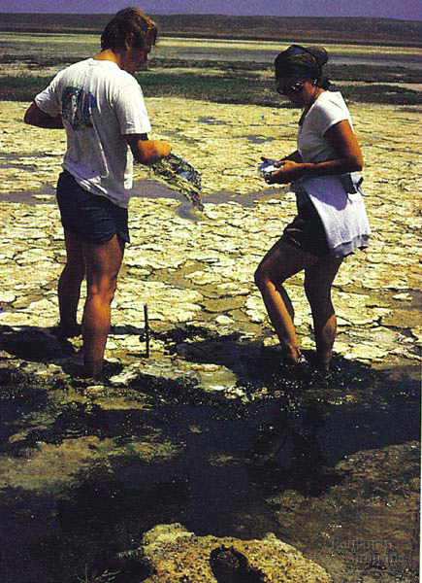
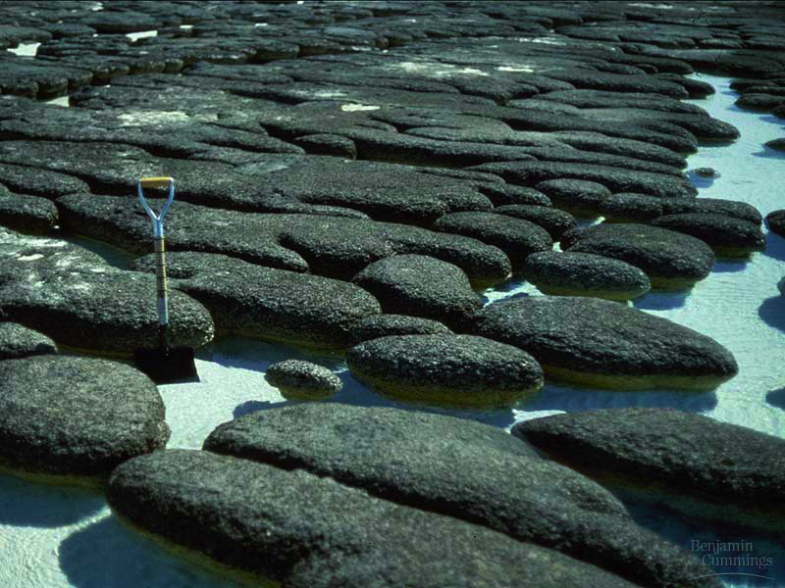
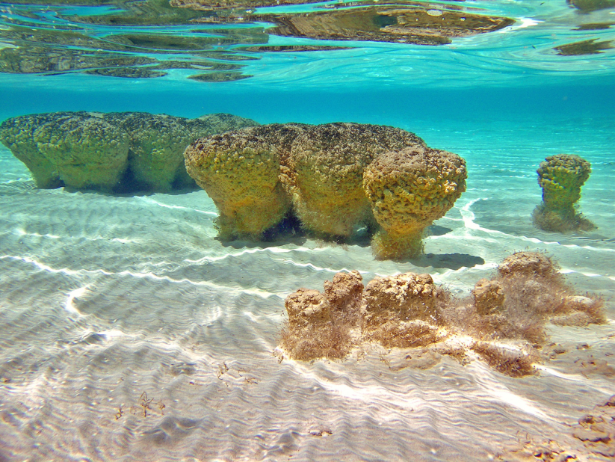
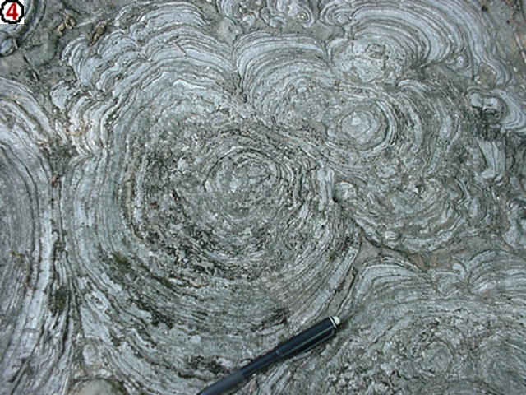
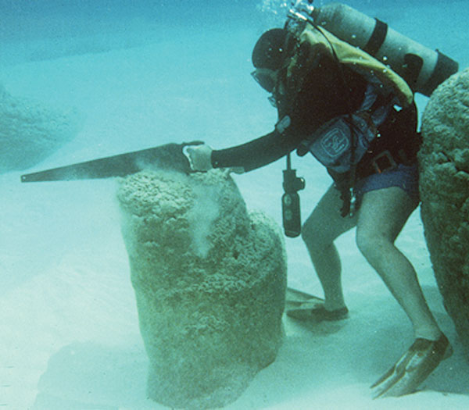
Stromatolites
Lynn Margulis
Fossilized mats of prokaryotes resemble modern microbial colonies

Slide 13
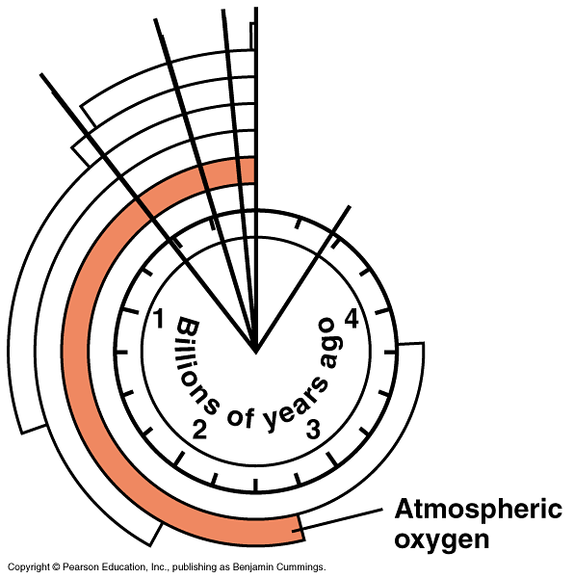
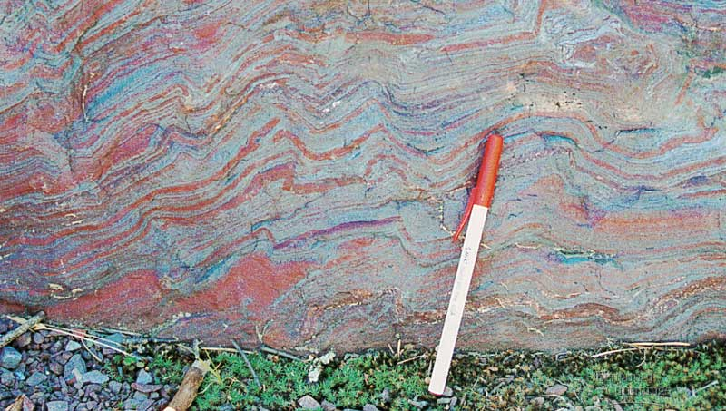
Oxygen atmosphere
Oxygen begins to accumulate 2.7 bya
  reducing → oxidizing atmosphere
    evidence in banded iron in rocks = rusting
    makes aerobic respiration possible
  photosynthetic bacteria (blue-green algae)

Slide 14
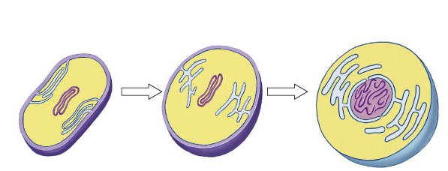
First Eukaryotes
~2 bya
Development of internal membranes
  create internal micro-environments
  advantage: specialization = increase efficiency
    natural selection!
endoplasmic
reticulum (ER)
nuclear envelope
infolding of the
plasma membrane
plasma
membrane
nucleus
DNA
cell wall
plasma
membrane
Prokaryotic
cell
Prokaryotic ancestor of eukaryotic cells
Eukaryotic
cell

Slide 15
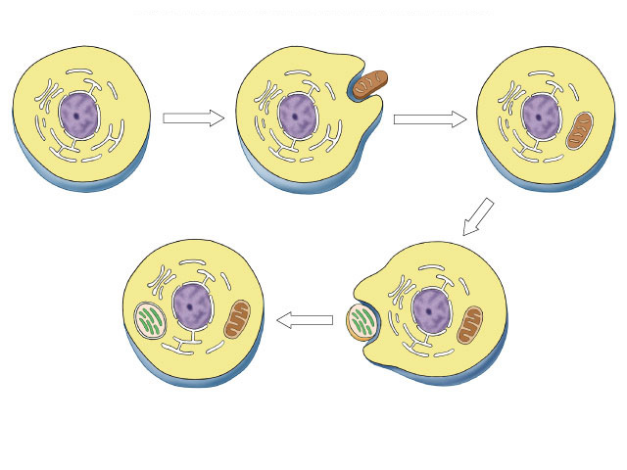
Endosymbiosis
Evolution of eukaryotes
  origin of mitochondria
  engulfed aerobic bacteria, but
  did not digest them
  mutually beneficial relationship
    natural selection!
internal membrane system
aerobic bacterium
mitochondrion
Endosymbiosis
Ancestral
eukaryotic cell
Eukaryotic cell
with mitochondrion

Slide 16
Endosymbiosis
Eukaryotic
cell with
mitochondrion
Evolution of eukaryotes
  origin of chloroplasts
  engulfed photosynthetic bacteria,
  but did not digest them
  mutually beneficial relationship
    natural selection!
photosynthetic
bacterium
chloroplast
Endosymbiosis
mitochondrion
Eukaryotic cell with
chloroplast & mitochondrion

Slide 17
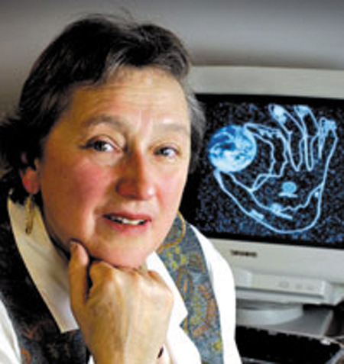
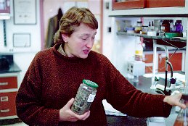
Theory of Endosymbiosis
Evidence
  structural
    mitochondria & chloroplasts
    resemble bacterial structure
  genetic
    mitochondria & chloroplasts
    have their own circular DNA, like bacteria
  functional
    mitochondria & chloroplasts
    move freely within the cell
    mitochondria & chloroplasts
    reproduce independently
    from the cell
Lynn Margulis

Slide 18
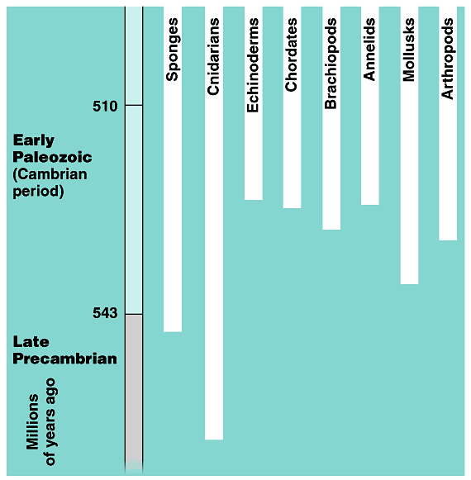
Cambrian explosion
Diversification of Animals
  within 10–20 million years most of the major phyla of animals appear in fossil record
543 mya

Slide 19
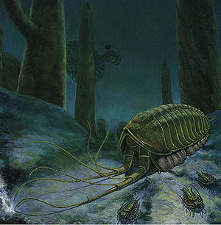
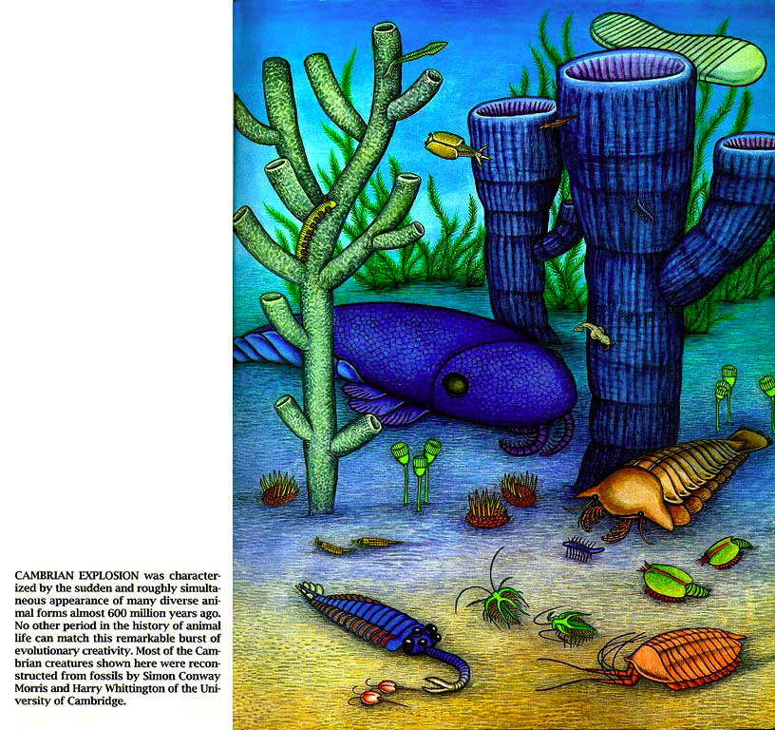
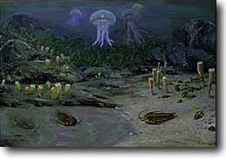


Slide 20
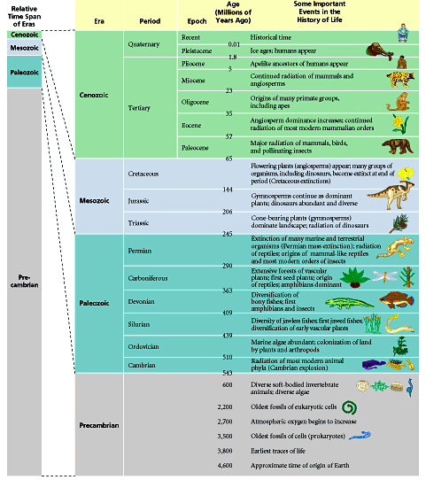
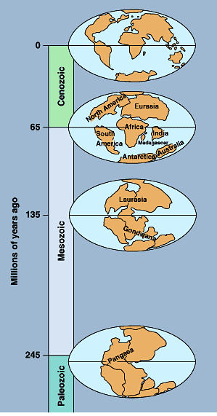

Slide 21
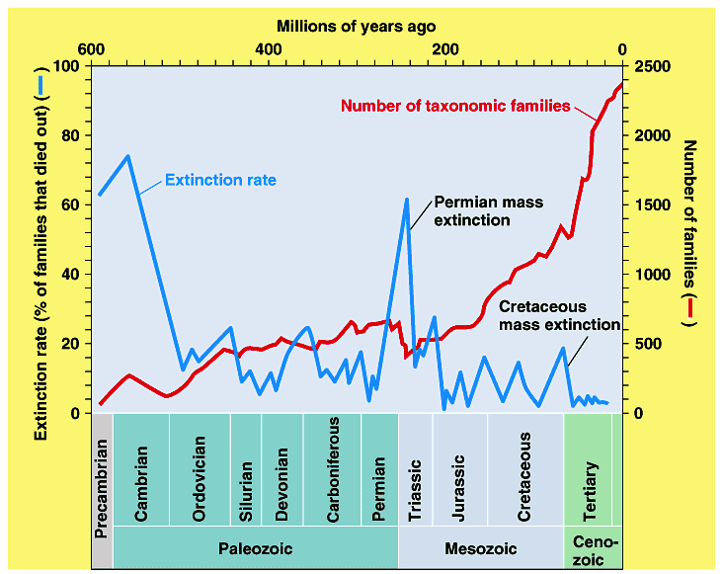
Diversity of life & periods of mass extinction
Cambrian explosion
Notes:
Diversity of life and periods of mass extinction. The fossil record of terrestrial and marine organisms reveals a general increase in the diversity of organisms over time (red line and right vertical axis). Mass extinctions, represented by peaks in the extinction rate (blue line and left vertical axis) interrupted the buildup of diversity. The extinction rate is the estimated percentage of extant taxonomic families that died out in each period of geologic time.
The fossil record chronicles a number of occasions when global environmental changes were so rapid and disruptive that a majority of species were swept away Such mass extinctions are known primarily from the decimation of hard–bodied animals that lived in shallow seas, the organisms for which the fossil record is most complete. Two mass extinctions—the Permian and the Cretaceous—have received the most attention. The Permian mass extinction, which defines the boundary between the Paleozoic and Mesozoic eras, claimed about 96% of marine animal species. Terrestrial life was also affected. For example, 8 out of 27 orders of insects were wiped out. This mass extinction occurred in less than 5 million years, possibly much less—an instant in the context of geologic time. The Cretaceous mass extinction of 65 million years ago, which marks the boundary between the Mesozoic and Cenozoic eras, doomed more than half of all marine species and exterminated many families of terrestrial plants and animals, including most of the dinosaurs.

Slide 22
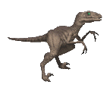
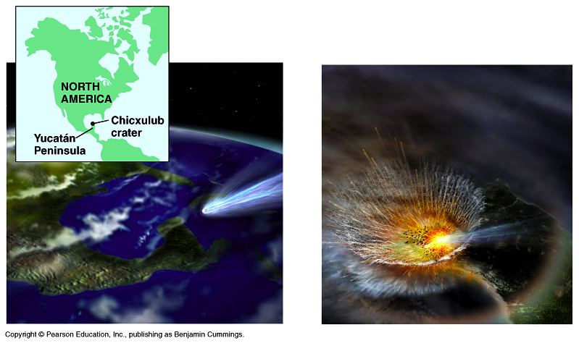
Cretaceous extinction
The Chicxulub impact crater in the Caribbean Sea near the Yucatan Peninsula of Mexico indicates an asteroid or comet struck the earth and changed conditions 65 million years ago
Notes:
Trauma for Earth and its Cretaceous life.
One clue to a possible cause of the Cretaceous mass extinction is a thin layer of clay enriched in iridium that separates sediments from the Mesozoic and Cenozoic eras. Iridium is an element very rare on Earth but common in many of the meteorites and other extraterrestrial objects that occasionally fall to Earth. Walter and Luis Alvarez and their colleagues at the University of California proposed that this clay is fallout from a huge cloud of debris that billowed into the atmosphere when an asteroid or a large comet collided with Earth. This cloud would have blocked sunlight and severely disturbed the global climate for several months.
Where did the asteroid or comet hit? Research has focused on the Chicxulub crater. The 65 million–year–old Chicxulub impact crater is located in the Caribbean Sea near the Yucatán Peninsula of Mexico. The horseshoe shape of the crater and the pattern of debris in sedimentary rocks indicate that an asteroid or comet struck at a low angle from the southeast. This artist’s interpretation represents the impact and its immediate effect—a cloud of hot vapor and debris that could have killed most of the plants and animals in North America within hours. About 180 km in diameter, the crater is the right size to have been caused by an object with a diameter of 10 km.

Slide 23
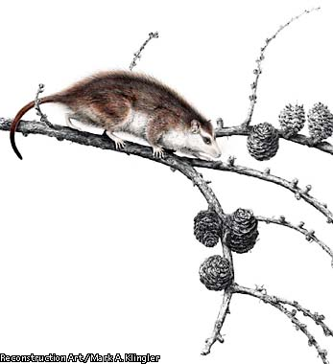
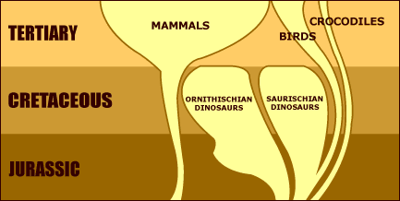
Early mammal evolution
125 mya mammals
began to radiate
out & fill niches
Notes:
The first mammals evolved from a group of mammal-like reptiles called therapsids about 220 million years ago during the Triassic period. The therapsids were among the very few reptiles in a subgroup called "synapsids" that had just barely survived the great dying at the end of the Permian, about 250 million years ago. This massive extinction event was the most severe and dramatic in the history of life on earth and marks the end of the Paleozoic era. More than 90 percent of all marine species were wiped out, including every species of the familiar trilobite; 75 percent of the reptile and amphibian species, including most of the mammal-like reptiles were likewise eliminated.

Slide 24
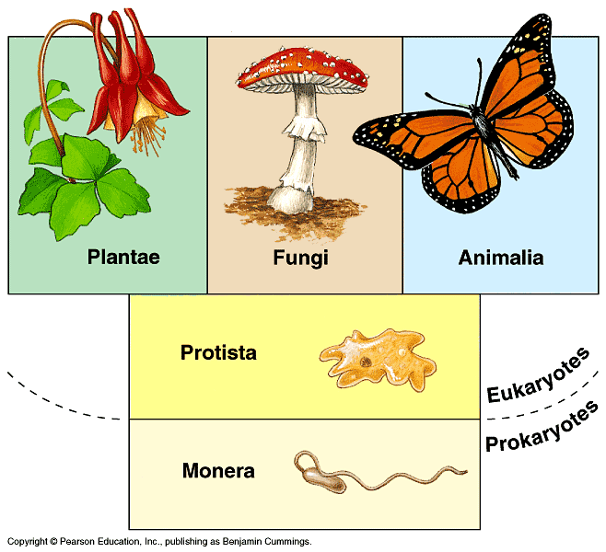
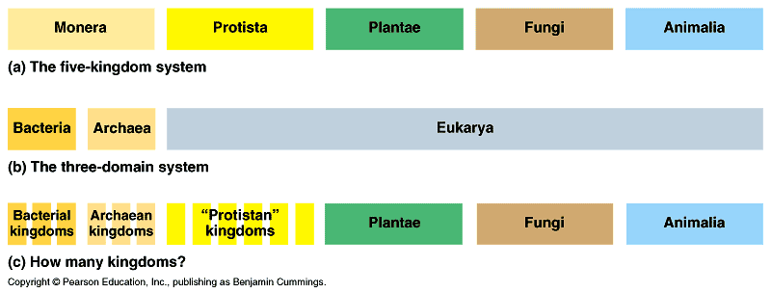
Classifying Life
Molecular data
challenges 5 Kingdoms
    Monera was too diverse
      2 distinct lineages of prokaryotes
    Protists are still too diverse
      not yet sorted out

Slide 25
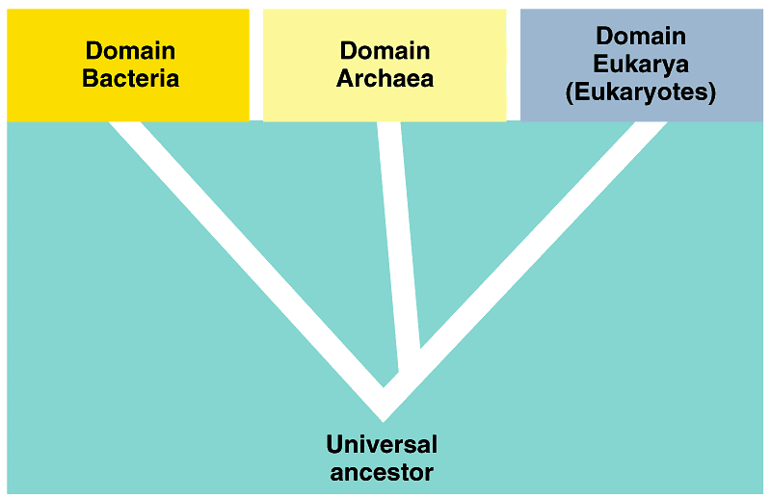
3 Domain system
Domains = “Super” Kingdoms
  Bacteria
  Archaea
    extremophiles = live in extreme environments
      methanogens
      halogens
      thermophiles
  Eukarya
    eukaryotes
      protists
      fungi
      plants
      animals

Slide 26
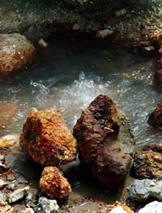
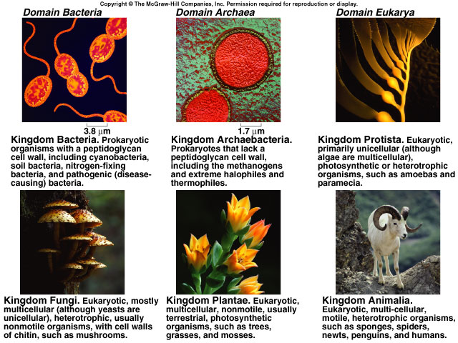
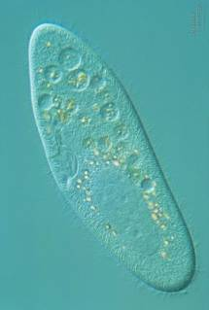
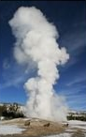
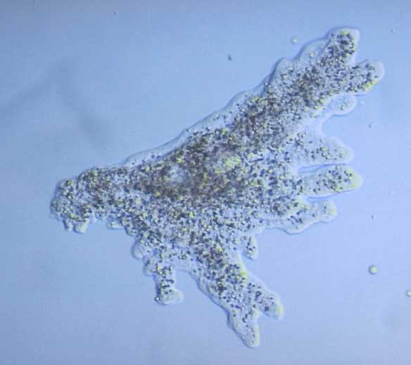
Kingdom
Bacteria
Kingdom
Archaebacteria
Kingdom
Protista
Kingdom
Fungi
Kingdom
Plantae
Kingdom
Animalia

Slide 27
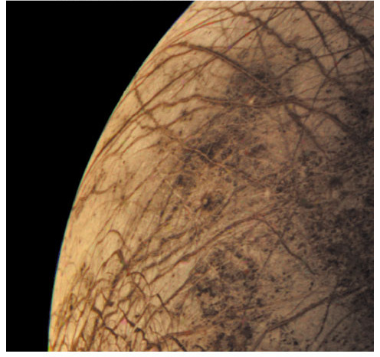
Any Questions??
Is there life elsewhere?
Does it look like life on Earth?

